Slide 1
EE mappings for PTM/HM probes
S.Zelepoukine
16.Jun.09

Slide 2
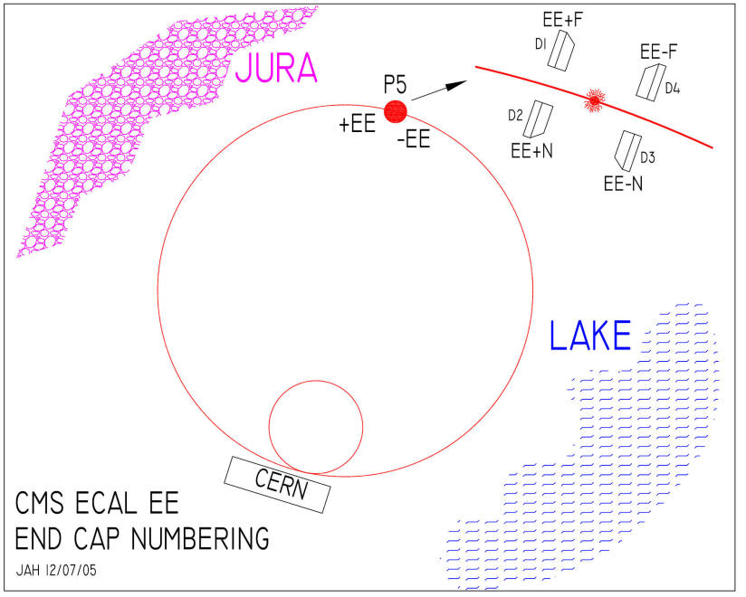
Dee location/naming

Slide 3
EE+ Backplates
PTM_17
PTM_18
179
568
PTM_19
PTM_20
223
546
EE+N
Dee-2
EE+F
Dee-1
PTM_20
PTM_19
565
541
PTM_18
PTM_17
355
543
Probes are located on BP surface
at the electronics side
View from CMS IP

Slide 4
EE- Backplates
PTM_17
PTM_18
578
371
PTM_19
PTM_20
572
452
EE-F
Dee-4
EE-N
Dee-3
PTM_20
PTM_19
419
442
PTM_18
PTM_17
573
441
Probes are located on BP surface
at the electronics side
View from CMS IP

Slide 5
EE+ env.screens
PTM_23
PTM_24
431
PTM_21
PTM_22
427
554
435
EE+N
Dee-2
EE+F
Dee-1
PTM_22
PTM_21
430
433
PTM_24
PTM_23
426
434
Probes are located on
the inner screen surface
View from CMS IP

Slide 6
EE- env.screens
PTM_23
PTM_24
460
PTM_21
PTM_22
416
420
450
EE-F
Dee-4
EE-N
Dee-3
PTM_22
PTM_21
448
421
PTM_24
PTM_23
428
453
Probes are located on
the inner screen surface
View from CMS IP

Slide 7
EE+ Cool.blks
PTM_1,2
PTM_15,16
PTM_3,4
PTM_13,14
PTM_5,6
PTM_11,12
PTM_7,8
PTM_9,10
EE+N
Dee-2
EE+F
Dee-1
PTM_9,10
PTM_7,8
PTM_11,12
PTM_5,6
PTM_13,14
PTM_3,4
PTM_15,16
PTM_1,2
Probes are located in pairs on
the input/output CB’s pipes:
PTM_<in>,<out>
View from CMS IP

Slide 8
EE- Cool.blks
PTM_1,2
PTM_15,16
PTM_3,4
PTM_13,14
PTM_5,6
PTM_11,12
PTM_7,8
PTM_9,10
EE-F
Dee-4
EE-N
Dee-3
PTM_9,10
PTM_7,8
PTM_11,12
PTM_5,6
PTM_13,14
PTM_3,4
PTM_15,16
PTM_1,2
Probes are located in pairs on
the input/output CB’s pipes:
PTM_<in>,<out>
View from CMS IP

Slide 9
EE HM probes
HM_01
HM_04
HM_02
HM_03
EE+F
Dee-1
EE+N
Dee-2
EE-F
Dee-4
EE-N
Dee-3
HM_03
HM_02
HM_04
HM_01
Probes are located on
the input CB’s pipes
View from CMS IP

Slide 10
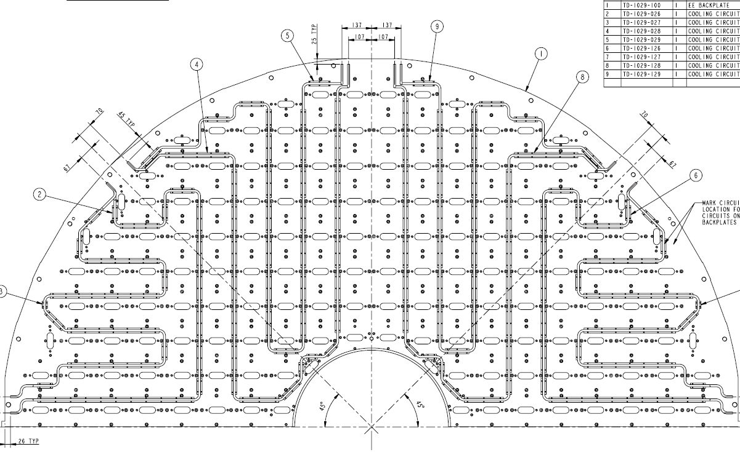
Example: EE Dee-4: PTM probes on the backplate
(view from the electronics side)
572
419
578
573

Slide 11
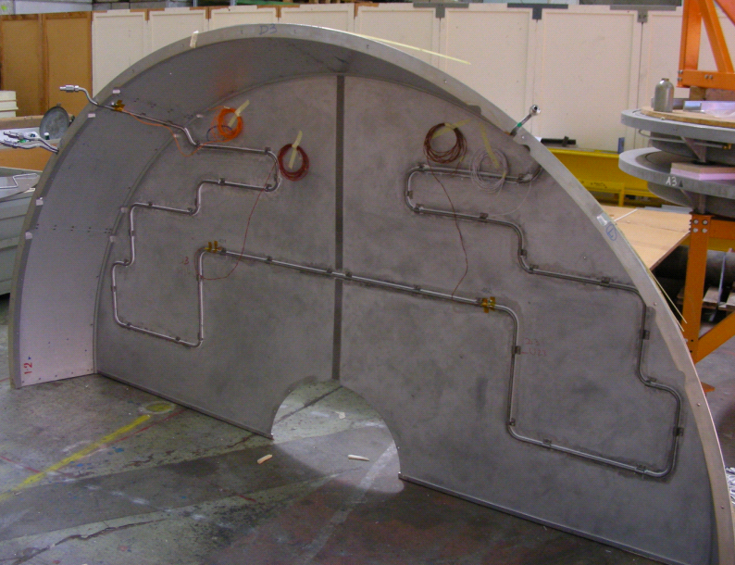
Example: PTM probes on the environmental screen

Slide 12
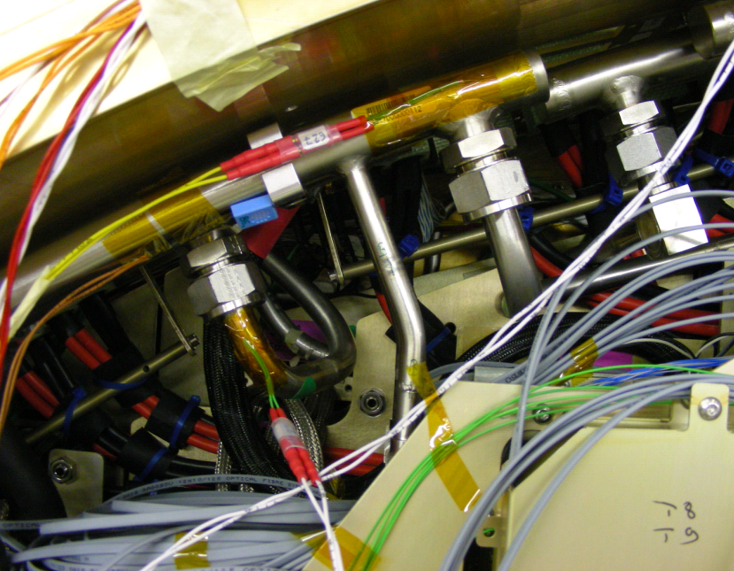
Example: PTM probes on CB’s in/out pipes
HM probes
Note: all probes are protected with armaflex (not shown)
HM probe

