Slide 1
Tier1 Site Report
HEPSysMan, RAL
10-11 June 2010
Martin Bly, STFC-RAL

Slide 2
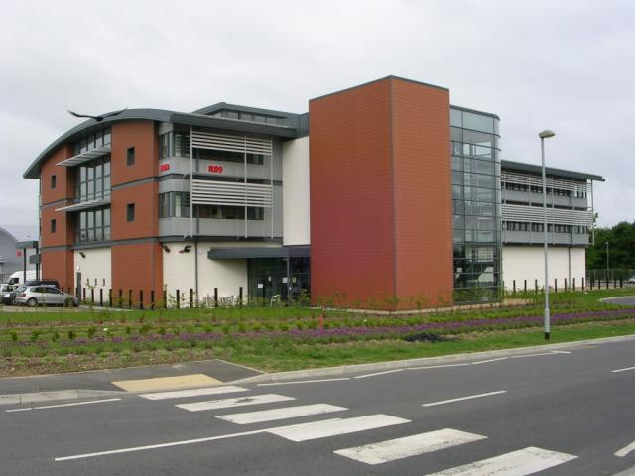
Overview
RAL Stuff
Building stuff
Tier1 Stuff

Slide 3
STFC Developments
Shared Services Centre
Provides common services to all the Research Councils:
HR, Payroll, Procurement, Appraisal ...
Aim is to provide savings over ‘doing it ourselves’ and by adopting common standards
STFC HR, payroll, procurement now running via SSC
Mostly positive experience for procurement
Program underway to look at ‘IT’ procurement needs and processes
Science computing difficult to fit into this model
Framework agreements being set up
Speedier procurement of small batches
Wider selection types of IT kit available – not just servers
But may limit choice
Need to track competitiveness against outsiders
Do other sites use frameworks and is it a benefit?

Slide 4
RAL Site
Plan to remove support for old-style f.blogs@rl.ac.uk email addresses in favour of the cross-site standard fred.bloggs@stfc.ac.uk - still under discussion
significant resistance to this
no date as yet
International Space Innovation Centre
“A new environment where government, universities and industry can work together to better exploit scientific opportunities and create new technologies, applications and IP that exploits UK, European and Global Space Programmes”
Will focus on three key areas initially:
Understanding and countering Climate Change
Ensuring the Security of space systems and services
Exploiting the data generated by Earth Observation satellites
Notes:
Other Campus developments?

Slide 5
Building Stuff
UPS problems
Leading power factor due to switch-mode PSUs in systems
Causes 3KHz ringing on current, all phases
Load is small (80kW) compared to capacity of UPS (480kVA).
Most kit stable but EMC AX4-5 FC arrays unpredictably detect supply failure and shut down arrays
Longer feed cable from UPS to PDU has made 50% reduction in distortion
Proposed long-term solution: isolation transformer
New chillers + pumps
Additional 1500kW cooling capacity: 4 chillers in 3+1 redundant configuration to provide at total of 2250kW
Additional and replacement higher capacity pumps fitted
Dust in machine rooms

Slide 7
FY 09/10 Procurements
98 x SuperMicro 4U/24-bay chassis with 2TB SATA HDD
RAID6 (40TB) or RAID6+1 (38TB) on Adaptec or LSI controllers
~3.8PB useable, Site => ~8PB
21 x SuperMicro Twin², 2 x E5520, 3GB/core, 1T HDD
21 x HP SL6000 4-up chassis, 2 x E5520, 3GB/core, 1T HDD
~15,500 HS06, Site => ~49,700 HS06, ~5260 cores
FC storage arrays: 7 x Infortrend
iSCSI arrays: 2 x Infortrend
40+ Dell R410 servers
Tape servers, virtualisation and services hosts
5 HP DL360 database servers with FC
Notes:
Usual litany of hardware updates.

Slide 8
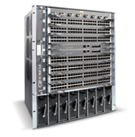
Networking
Additional Force10 C300
Twin for existing C300
‘Spares’, testing
To be configured as a resilient routing pair
WAN developments
Existing 10Gb/s site link to SuperJanet5 being doubled to 20Gb/s
Failover capacity maintained
LHCOPN failover link @ 10Gb/s
Both being commissioned
LAN developments
RAL campus network-futures plan in development

Slide 10
Storage Commissioning I
One of two batches of the FY08/09 capacity storage failed acceptance testing: 60/110 servers (~1.2PB)
Rapid onset of failure mode
Supplier involved
Significant testing with various ‘solutions’ unsuccessful
Escalated to HDD OEM
Additional testing program started
HDD FW variants
Unable to identify cause of problems
Supplier/OEM agree swap out of disks
Combination clearly doesn’t work despite compatibility list!

Slide 11
Storage Commissioning II
One of two batches of FY09/10 capacity storage delayed in proving tests: 60/98 servers (~2.3PB)
Multiple drive throws
Disks tested show now issues
Supplier and OEMs involved
New firmware for both controllers and drives
Flash in-situ
Successful proving test
Now in acceptance testing

Slide 12
Drive Failure Rates

Slide 13
Benchmarks

Slide 14
Fabric Management
Deployment with QUATTOR
Already Deployed:
Worker nodes, Batch server, UK-BDII, LHCb VO box
In Progress now:
Disk Servers, CEs, LFC, Local BDII
Plan:
All system types Quattorised by December 2010
Final catch up rollout during end of year stop

Slide 15
Grid Services
SL4 to SL5 migration for batch workers
FroNTier deployment
LFC cleanup
FTS upgrade (to version 2.2.3)
glexec deployment, SCAS/pilot roles in progress.
Updates to hardware used for Top-BDII quintet.
Other improvements in resilience e.g. enabling hot-swappable disks on WMS…

Slide 16
Castor
Done:
Nameserver upgrade to 2.1.8-3 (September)
SRM update to 2.8-1 (October)
Database disk array problem and subsequent rewinding of database. (October)
Oracle database quarterly patching (November)
Move back to original disk arrays (January)
Update memory in database nodes (February)
To come:
New database architecture and hardware
Updates to Castor (2.1.8/2.1.9)

Slide 17
Questions?

