Slide 1
Edinburgh (ECDF) Update
Wahid Bhimji
On behalf of the ECDF Team
HepSysMan ,10th June 2010
Edinburgh Setup
Hardware upgrades
Progress in last year
Current Issues

Slide 2
Edinburgh Setup
Group computing:
Managed centrally within physics dept.
~30 Desktops: SL5 + ~ 15 Laptops
New(ish) storage Servers: ~20TB shared
gLite tarball UI + Local Atlas KITs etc.
Local Condor pool: > 300 cores
Grid Computing:
ECDF - Edinburgh Compute and Data Facility

Slide 3
What is ECDF?
Edinburgh Compute and Data Facility
University wide shared resource
~7% (AER) GridPP fairshare use.
Cluster (and most middleware hardware) maintained by central systems team.
Griddy extras maintained by:
Wahid Bhimji – Storage Support (~0.2 FTE)
Andrew Washbrook – Middleware Support (~0.8)
ECDF Systems Team (~0.3)
Steve Thorn - Middleware Support (~0.1)
In Physics
In IS Dept.

Slide 4
ECDF Total Resources - Compute
Current
128 dual (x2)
+ 118 quad core (x2)
Future (Eddie Mk2)
Two upgrade phases
Old quad-cores retained.
Phase 1 acceptance tests now!
Metric | Current | New Phase I
Nodes | 246 | 128
Cores | 1456 | 1024
Memory (GB) | 2912 | 3120
SPECfp2006_rate | 13111 | 20992
New Compute Nodes (Phase 1)
IBM iDataplex DX360 M3
CPU | 2 x Intel Westmere quad-core
Memory | 24GB DDR3

Slide 5
ECDF Storage - Current
Cluster storage: 160 TB, GPFS
– Previously not used by GridPP (except for homedirs and software areas (for which it is not the best anyway))
Now 10 TB available to GridPP via StoRM
Main GridPP Storage 30 TB:
“Standard” DPM + Pool Servers

Slide 6
Storage - Future
Cluster – Integrating with existing GPFS setup
IBM DS5100 storage platform
15k RPM 300GB FC drives
Metadata on SSDs
4x IBM X3650 M3 servers, 48GB RAM, 10GE
GridPP Bulk Storage
3 * (Dell R610 + 3 * MD1200) =~ 150 TB
Probably also GPFS – through Storm
Arriving today

Slide 7
General Status : Improvements since last year
Last Year’s talk (by Steve T):
“Problems: Staffing...” (Sam/ Greig had left – Andy/I just started that month)
Middleware: Many middleware nodes on SL3 (1/2 CEs, MON, UI, sBDII)
“GridPP share reduced (no more funding)” -> very few jobs running

Slide 8
Now
Staffing: Andy and I now (somewhat) established.
Middleware Services
New lcg-CE, StoRM SE and SL5 MON, BDII in place
Cream-CE - SGE compatibility being validated - will replace the older lcg-CE host
Good reliability:
ECDF utilisation
Guaranteed fair-share for four years (fixed share not usage)
Responds well to demand: e.g soaked up free cycles over Christmas to deliver ~half the cluster
Ops SAM | Q3 `09 | Q4 `09 | Q1 `10 | Q2 `10
% | 91% | 93% | 94% | 98%

Slide 9
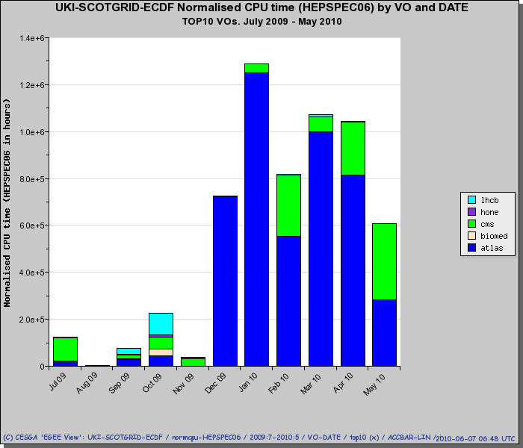
So delivery improved
We’re still small but
Get >100% “wall clock time” CPU utilization
(fairshare of big cluster allows us to get back at busy times the under utilization of quiet ones)

Slide 10
And…
SL5 Migration Successful
ECDF moved nodes slowly to SL5 started July `09, ending ~March this year.
GridPP switch to SL5 performed in October `09 – very smooth but then some issues with package (and CMT) dependencies for LHCb and ATLAS.
Non-LHC VO Support
Providing support to integrate UKQCD software (DiGS) with SRM (tested on both storm and DPM)
ATLAS Analysis testing
Series of Hammercloud tests completed in Jan ’09 on current DPM setup
Site is analysis ready – though slots / space are limited
Expect to increase scope with new storage

Slide 11
StoRM/GPFS
New StoRM 1.5 node
Currently mounts existing cluster GPFS space over NFS (using a NAS cluster) (systems team don’t want us to mount the whole shared GPFS FS)
WNs mount this GPFS space “normally”
Initial ACL issue
Storm sets then checks acl immediately. So (intermittently) failed due to nfs client attribute caching. Mounting with noac option "fixes" it.
Validation tests completed:
Sam tests / lcg-cp etc.
Single ATLAS analysis jobs run well on GPFS (> 90% CPU eff compared to ~70 % for rfio)
Planning hammercloud tests for this setup though ultimately will be using new storage servers

Slide 12
Not all there yet – issues
GPFS grief (on software and home dirs) (ongoing – though an easy “fix”):
Shared resource so limited ability to tune for uses.
LHCb SAM test recursively lists 72000 files in all previous versions of ROOT.
LHCb software install recursively chmods its many many directories
CMS accesses multiple shared libraries in SW area put strain on WNs.
ATLAS SW area already moved to NFS – will need to move others too
CA Sam Test Timeouts (goingon forever)
In listing CAs after RPM check
GPFS? - but /etc/grid-security now local on WN and interactively works
MON box didn’t publish during SL4/5 switchover (resolved)
it couldn’t deal with dashes in queue name
Clock skew in virtual instances causing authentication problems (resolved) VMware fix in.

Slide 13
CE issues
Some issues in our shared environment e.g.:
Can’t have yaim do what it wants to an SGE master.
Have to use batch system config / queues that exist … etc…
Current issues include:
Older lcg-ce load goes mental from time to time
CMS jobs? globus-gatekeeper and forks ? Hopefully CREAM will be better
New LCG-CE WMS submission to the SGE batch system :
Jobs are terminated prematurely before the output is collected: even ATLAS CE-sft-job SAM test fails (sometimes). No obvious pattern to job failures observed.
CREAM and SGE:
Possible issues from requirement of a SGE stagein script to be put in the main SGE prolog and epilog scripts
Don’t want this script to be run for all jobs submitted to the batch system
Looking at alternatives e.g. conditional execution based on gridpp

Slide 14
Conclusions
Many improvements in middleware, reliability and delivery since we were here in 09
New hardware available soon - significant increases in resource
Shared service is working here: but it’s not always easy

