Slide 1
Royal Holloway site report
Simon George
HEPSYSMAN @ RAL 10-11 Jun 2010

Slide 2
Contents
Staff & basics
Tier2 relocation & upgrade
Tier3 cluster upgrade
Local storage upgrade
CC services
Forthcoming procurements

Slide 3
Computing staff & basic portfolio
Diego Bellini (main sysadmin)
Leaving 2 July
Govind Songara (Grid site admin)
Simon George (local/Tier2 manager)
Barry Green (hardware & general support)
Maintaining usual local systems & services
Desktops (SLC5), laptops (Win/Mac/Linux), printers
Windows TS
Network and firewall, Wifi
Nagios, DHCP/PXE/kickstart, DNS, email
TWiki, web, SVN, elog, etc.
Videoconference suite
Notes:
WinXP still
Laptop O/S mainly latest Fedora.

Slide 4
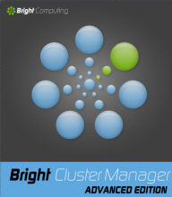
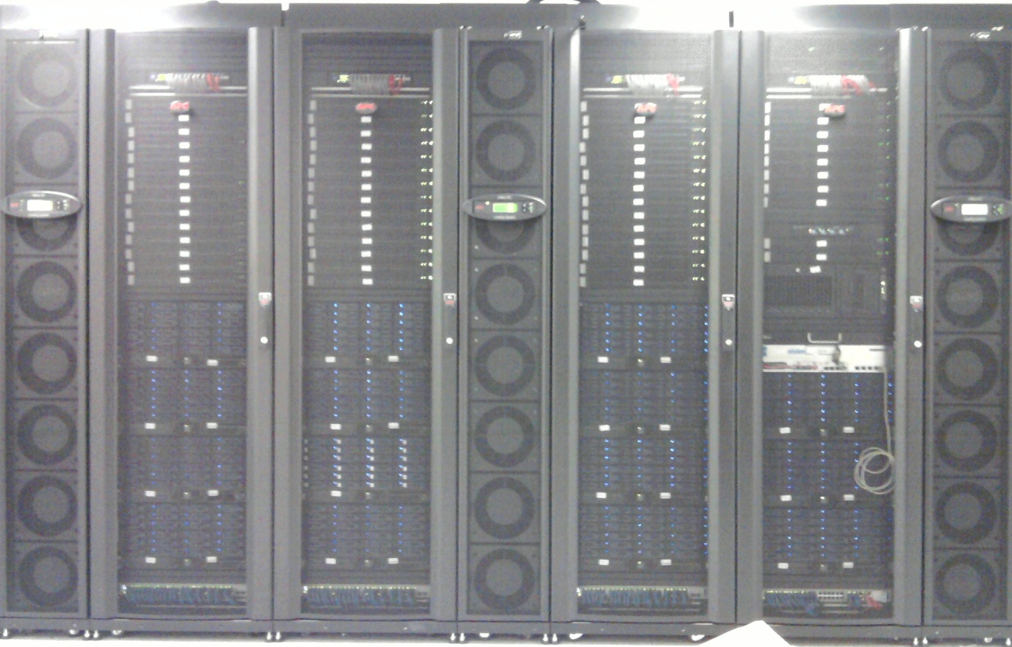
Tier2 cluster
Govind Songara, Duncan Rand (LG tech coord)
Feb10 – successful relocation from IC to RHUL machine room
Installed in new APC racks
Upgraded to SL5 and BCM
Completely reinstalled gLite3.2 WN, SE, DPM
Kept old SL4 CE
Now back up and testing/running for main VOs.
It took much longer than anticipated to build the site back up from scratch, but it was a good learning experience.
Total CPU: 7.9 HS06 x 400 cores = 3160 HS06
Total storage: ~21 TB x 14 servers = ~294 TB
Ratio HS06/TB ~11
WN network: 2Gb/s bonded per 8 cores
Storage network: 4Gb/s bonded per server
Notes:
State of the art.
APC racks – enclosed hot aisle
Whole room is on UPS + generator
Excellent collaboration with CC.

Slide 5
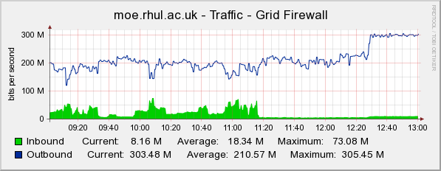
Tier2 network
Bad news: sharing 1Gb/s network with college
Dedicated 1Gb/s line still not provided
Long chain of request (includes LMN, BT)
Delayed by road digging problems
Hoping to get temporary additional connection through existing fibre.
Atlas transfers running at ~200 Mb/s
Capped at 300 Mb/s

Slide 6
Tier3
Govind Songara, Diego Bellini, Barry Green
Old Tier2 cluster circa 2004:
75 nodes x 2 P4 Xeon 3GHz, 2 GB RAM (4.17 HS06)
Upgraded 40 nodes:
AMD Phenom II 955 3.2GHz, (4 core) + 8GB RAM, to fit inside current power & heat constraints.
WNs built by academics!
from our detailed instructions
~4 man days
For local use:
Atlas analysis
Accelerator simulations (MPI)
Rapid deployment using our standard workstation PXE/kickstart install
Torque/maui
Next: MPI, cobbler/cfengine.
Total CPU:
13.25 HS06 x 160 cores = 2120 HS06
(was 625)
Total storage: 60 TB scratch via NFS
Notes:
Total upgrade cost ~£22k

Slide 7
Local storage
To meet demands of local ATLAS analysis and expanding accelerator group
Scratch server
PC hardware, 48-slot server, 2TB disks
2x ARC1280
4xRAID6+8HS (lower rebuild times) => 64TB
Heavily run in (repeatedly fill and file system) to tease out ~10 dodgy disks
Linux SLC5, XFS
NFSv3, bonded 2Gb/s ethernet
~60 clients including 40 Tier3 WNs
‘Home’ file space with backups
To replace old sun E450 ~100 GB and LTO2 20-tape library with ~12 TB + off-site backups
PC hardware (like Tier2 storage)
Solaris 10, ZFS, software support contract
NFSv3, bonded 2Gb/s ethernet
Backup to CC system
Problems encountered:
HP protector: won’t visit nested file systems – see later
Solaris/ZFS ARC cache exhausting system memory - limited it and plan mem upgrade
Disk (Samsung HD103UJ) timeouts too slow for controller – drop out although fine. Tuned some settings in firmware.
Notes:
Scratch: we have a 48-bay server full of 2TB disks used as local nfs-mounted scratch space. Apart from some problems running in the disks, it has been working fine. The configuration is a bit complicated because we couldn't get a single controller that can take 48 disks. So we have two ARC-1280 controllers, each making two RAID6 volumes of 10 disks + 2 hot spares giving 16TB per volume. (Could have gone for 24 disks per volume but we were worried about the rebuild time.) We then combine them into a single logical volume at the o/s level. For network we have bonded 2 Gb ethernet together. This is working ok on our local network where people are saving their data for desktop-based analysis, but I suspect you would need 10Gb for any significant number of worker nodes. No problems with the large box other than that is is very heavy. We inserted the disks after putting it in the rack, but it still took 2 strong people. So not clear it is better than two 24-disk boxes unless it saves a lot of money and you are sure you can get the bandwidth.

Slide 8
‘Home’ server configurations
Primary server:
optimised for reliability (double raid5) and recovery time
user1
user2
user3
user4
…
raidz1 pool (12TB)
Solaris 10
RAID5
RAID5
RAID5
RAID5
RAID5
RAID5
RAID5
HS
HS
HS
ARC 1280
1TB
1TB
1TB
1TB
1TB
1TB
1TB
1TB
1TB
1TB
1TB
1TB
1TB
1TB
1TB
1TB
1TB
1TB
1TB
1TB
1TB
1TB
1TB
1TB
Backup server:
optimised for space but still raid6 for reliability
user1
user2
user3
user4
…
raidz2 pool (22TB)
Solaris 10
J
B
O
D
J
B
O
D
J
B
O
D
J
B
O
D
J
B
O
D
J
B
O
D
ARC 1280
1TB
1TB
1TB
1TB
1TB
1TB
1TB
1TB
1TB
1TB
1TB
1TB
1TB
1TB
1TB
1TB
1TB
1TB
1TB
1TB
1TB
1TB
1TB
1TB

Slide 9
Backup procedure
Primary server: /home/user1
Provide users with self-service backups
Snapshots => no duplication, space efficient
4 weeks is easily accommodated
temp snapshot
User workstation/ Tier3 WN
rsync daily
NFS
/home/user1/
/backup/user1/
daily snapshots
NFS
Backup server: /home/user1
Day-1
Day-2
Replace old LTO2 tape system
Using HP protector for off-site backup to CC virtual tape library
Auto replication across 2 sites
Problem so far: cannot visit nested fs – maintenance of /home/* list by hand in GUI.
Workaround: copy snapshot to temporary single fs before backup.
…
Day-30
Central Computing HP virtual tape library, replicated at two sites
HP Protector client
Notes:
Rsync loses ZFS ACLs, but we don’t use them and it’s faster than zfs send/receive.
ARC cache memory problems was DoSing system – upgraded s/w, reduced memory it is allowed to gobble up and planning to increase memory.

Slide 10
Central Computing services
In the light of:
Good experience of CC hosting our Tier2 cluster
CC having upped their game significantly in recent years
Reduction in funded HEP sysman effort
Review what can be done by CC
Benefit from their economies of scale
Reduce HEP sysman effort
Refocus on what we do that is unique
Maybe increase equipment/consumables costs
Examples: RHEL5 VMs, NAS, virtual desktops, backups
So far
just migrating services that are replicated centrally
E.g. email & DNS
Hope to start tests with VMs and NAS soon
Notes:
What do we do that is unique?
Looks like Grid (although that could change in next few years as CS just got into HPC),
Linux desktop/laptop (maybe as a department rather than a group)
And high level of specialised user support, which maybe we just can’t afford any more.

Slide 11
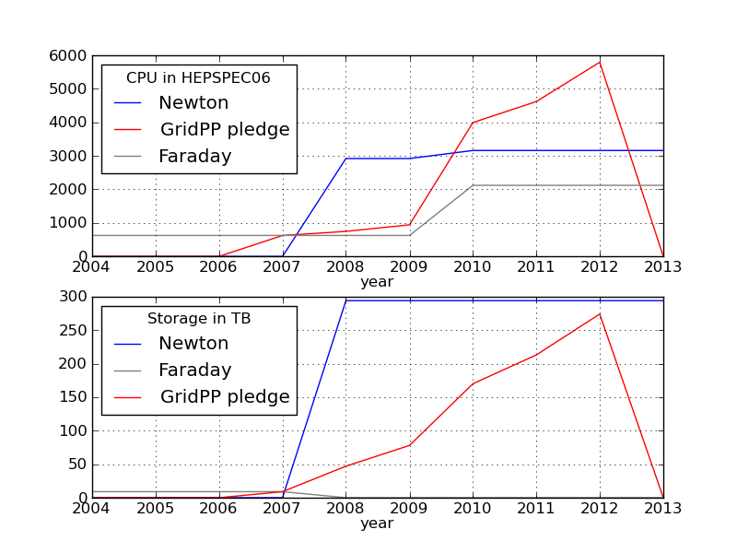
Forthcoming procurements
Tier2: need to double HS06 by 2012 to meet GridPP pledge
Storage within pledge but will also increase to maintain balance with CPU
Target ratio ~10 HS06/TB
First round later this year – focus on CPU
Anyone using the ATLAS/Dell deal?
How good are the prices?
Push for 2 Gb/s network to LMN once we have 1 Gb/s
(Tier2)
(Tier3)

Slide 12
Conclusions
Trends:
Grid expansion continues, both Tier2 & 3
Network link to LMN is still bottleneck for Tier2
Lost support effort in grant => do less
Moving to model where computer centre provide services and hosting.
Emphasis switching from local IT support to running Tier2/3 and managing SLAs.

