Slide 1


Liverpool HEP - Site Report
June 2010
John Bland, Robert Fay

Slide 2


Staff Status
No changes to technical staff since last year:
Two full time HEP system administrators
John Bland, Robert Fay
One full time Grid administrator (0.75FTE)
Steve Jones, started September 2008
Not enough!
Mike Houlden has retired and David Hutchcroft has taken over as the
academic in charge of computing.

Slide 3
Current Hardware - Users
Desktops
~100 Desktops: Scientific Linux 4.3, Windows XP, Legacy systems
Minimum spec of 3GHz ‘P4’, 1GB RAM + TFT Monitor
Hardware upgrades this Summer, SL5.x, Windows 7
Laptops
~60 Laptops: Mixed architecture, Windows+VM, MacOS+VM, Netbooks
Printers
Samsung and Brother desktop printers
Various OKI and HP model group printers
Recently replaced aging HP LaserJet 4200 with HP LaserJet P4015X

Slide 4
Current Hardware – ‘Tier 3’ Batch
‘Tier3’ Batch Farm
Software repository (0.5TB), storage (3TB scratch, 13TB bulk)
‘medium32’, ‘short’ queues consist of 40 32bit SL4 (3GHz P4, 1GB/core)
‘medium64’, ‘short64’ queues consist of 9 64bit SL5 nodes (2xL5420, 2GB/core)
2 of the 9 SL5 nodes can also be used interactively
5 older interactive nodes (dual 32bit Xeon 2.4GHz, 2GB/core)
Using Torque/PBS/Maui+Fairshares
Used for general, short analysis jobs
Grid jobs now also run opportunistically on this cluster

Slide 5
Current Hardware – Servers
~40 core servers (HEP+Tier2)
~60 Gigabit switches
1 High density Force10 switch
Console access via KVMoIP (when it works)
LCG Servers
SE 8-core Xeon 2.66GHz, 10GB RAM, Raid 10 array
  Unstable under SL4, crashes triggered by mysqldumps
  Temporarily replaced with alternate hardware
  Testing shows it appears to be stable under SL5
CEs, SE, UI, MON all SL4, gLite 3.1
BDII SL5, gLite 3.2
VMware Server being used for some servers and for testing
  MON, BDII, CE+Torque for 64-bit cluster, CREAM CE, all VMs

Slide 6
Current Hardware – Nodes
MAP2 Cluster
Still going!
Originally 24 rack (960 node) (Dell PowerEdge 650) cluster
Nodes are 3GHz P4, 1-1.5GB RAM, 120GB disk – 5.32 HEPSPEC06
2 racks (80 nodes) shared with other departments
18 racks (~700 nodes) primarily for LCG jobs
1 rack (40 nodes) for general purpose local batch processing
3 racks retired (Dell nodes replaced with other hardware)
Each rack has two 24 port gigabit switches, 2Gbit/s uplink
All racks connected into VLANs via Force10 managed switch/router
  1 VLAN/rack, all traffic Layer3
Still repairing/retiring broken nodes on a weekly basis
But…

Slide 7
Current Hardware – Nodes
MAP2 Cluster (continued)
Its days are hopefully numbered
Internal agreement to fund replacement from energy savings
Proposed replacement will be 72 E5620 CPUs (288 cores) or equivalent
Power consumption will go from up to ~140kW to ~10.5kW (peak)

Slide 8
Current Hardware – Nodes
New cluster
Started with 7 dual L5420 nodes (56 cores with HEPSPEC06 8.01)
With last round of GridPP funding added 7 of:
  SuperMicro SYS-6026TT-TF quad-board 2U chassis
  Dual 1400W redundant PSUs
  4 x SuperMicro X8DDT-F motherboards
  8 x Intel E5620 Xeon CPUs
  96GB RAM
  8 x 1TB Enterprise SATA drive
  224 cores total

Slide 9
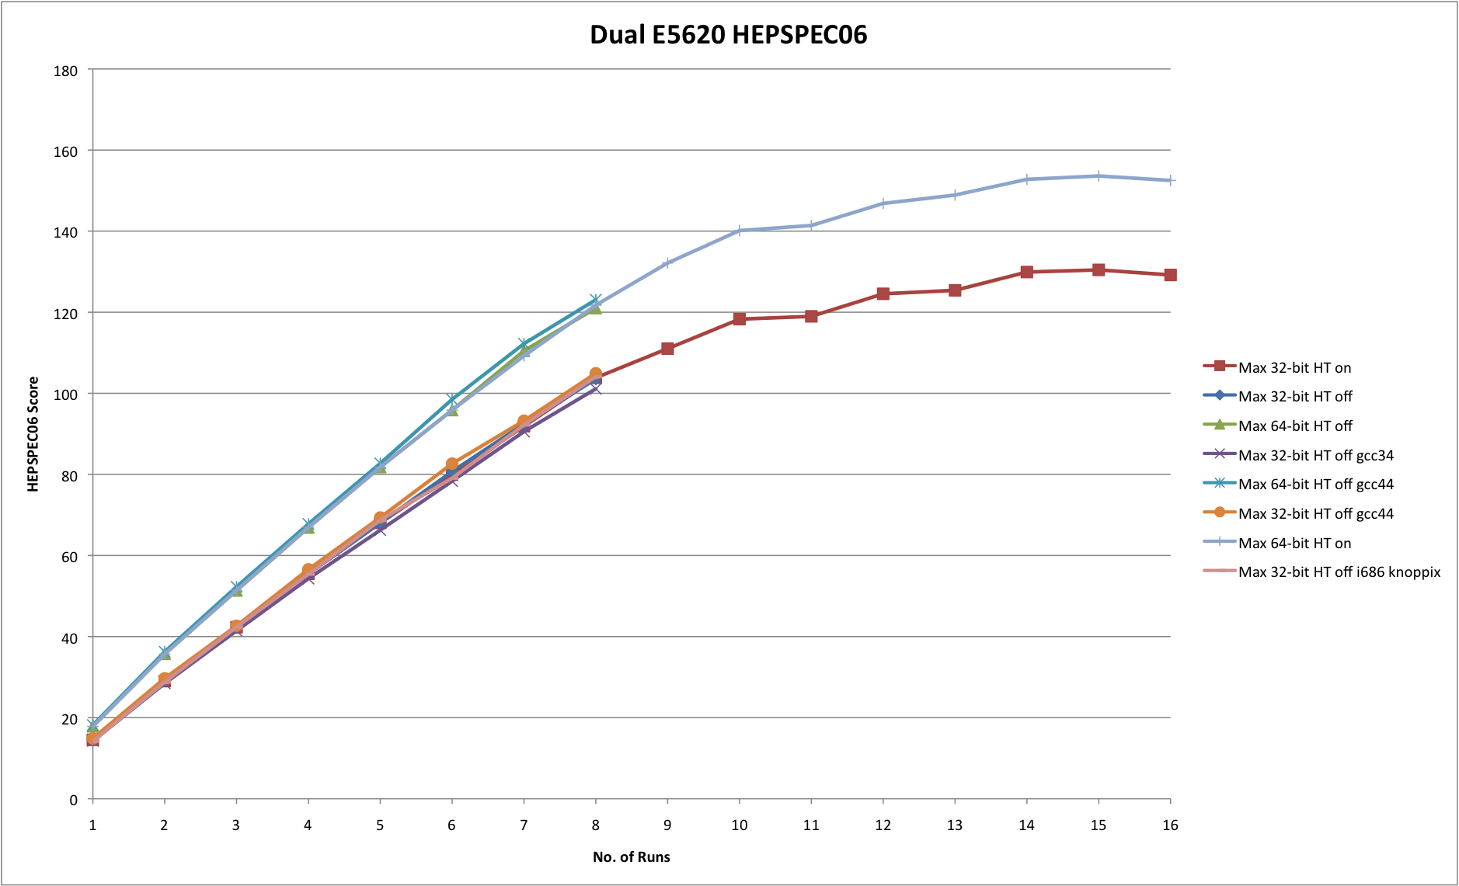
Current Hardware – Nodes

Slide 10

Storage
RAID
Majority of file stores using RAID6. Few legacy RAID5+HS.
Mix of 3ware and Areca SATA controllers
Adaptec SAS controller for grid software.
Scientific Linux 4.3, newer systems on SL5.x
Arrays monitored with 3ware/Areca web software and email alerts
Now tied in with Nagios as well
Software RAID1 system disks on all new servers/nodes.

Slide 11
Storage
File stores
13TB general purpose ‘hepstore’ for bulk storage
3TB scratch area for batch output (RAID10)
2.5TB high performance SAS array for grid/local software
Sundry servers for user/server backups, group storage etc
270TB RAID6 for LCG storage element (Tier2 + Tier3 storage/access via RFIO/GridFTP)

Slide 12
Storage - Grid
Now running head node + 12 DPM pool nodes, ~270TB of storage
  This is combined LCG and local data
  Using DPM as ‘cluster filesystem’ for Tier2 and Tier3
  Local ATLASLIVERPOOLDISK space token
Still watching Lustre-based SEs

Slide 13
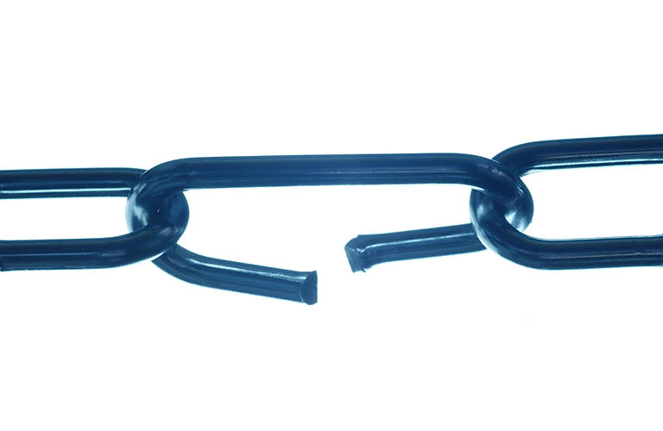
Joining Clusters
High performance central Liverpool Computing Services Department (CSD) cluster
Physics has a share of the CPU time
Decided to use it as a second cluster for the Liverpool Tier2
  Extra cost was second CE node (£2k)
  Plus line rental for 10Gb fibre between machine rooms
Liverpool HEP attained NGS Associate status
  Can take NGS-submitted jobs from traditional CSD serial job users
  Sharing load across both clusters more efficiently
Compute cluster in CSD, Service/Storage nodes in Physics

Slide 14
Joining Clusters
CSD nodes
  Dual quad-core AMD Opteron 2356 CPUs, 16GB RAM
  HEPSPEC06 7.84
  OS was SuSE10.3, moved to RHEL5 in February
  Using tarball WN + extra software on NFS (no root access to nodes)
Needed a high performance central software server
  Using SAS 15K drives and 10G link
  Capacity upgrade required for local systems anyway (ATLAS!)
  Copes very well with ~800nodes apart from jobs that compile code
    NFS overhead on file lookup is the major bottleneck
Very close to going live once network troubles sorted
  Relying on remote administration frustrating at times
  CSD also short-staffed, struggling with hardware issues on the new cluster

Slide 15
HEP Network topology
1G
2G
1G
1-3G
10G
192.168 Research VLANs
2G x 24
1500MTU
9000MTU

Slide 16
Configuration and deployment
Kickstart used for OS installation and basic post install
  Previously used for desktops only
  Now used with PXE boot for automated grid node installs
Puppet used for post-kickstart node installation (glite-WN, YAIM etc)
  Also used for keeping systems up to date and rolling out packages
  And used on desktops for software and mount points
Custom local testnode script to periodically check node health and software status
  Nodes put offline/online automatically
Keep local YUM repo mirrors, updated when required, no surprise updates (being careful of gLite generic repos)

Slide 17

Monitoring
Ganglia on all worker nodes and servers
Use monami with ganglia on CE, SE and pool nodes
  Torque/Maui stats, DPM/MySQL stats, RFIO/GridFTP connections
Nagios monitoring all servers and nodes
  Continually increasing number of service checks
  Increasing number of local scripts and hacks for alerts and ticketing
Cacti used to monitor building switches
  Throughput and error readings
Ntop monitors core Force10 switch, but still unreliable
  sFlowTrend tracks total throughput and biggest users, stable
LanTopolog tracks MAC addresses and building network topology
arpwatch monitors ARP traffic (changing IP/MAC address pairings).

Slide 18
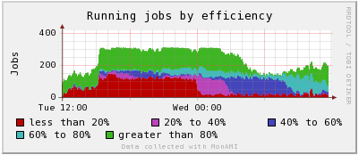
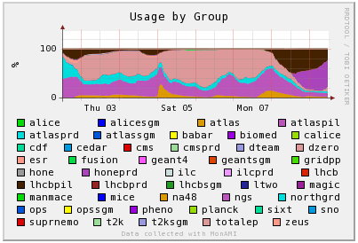
Monitoring - Monami

Slide 19
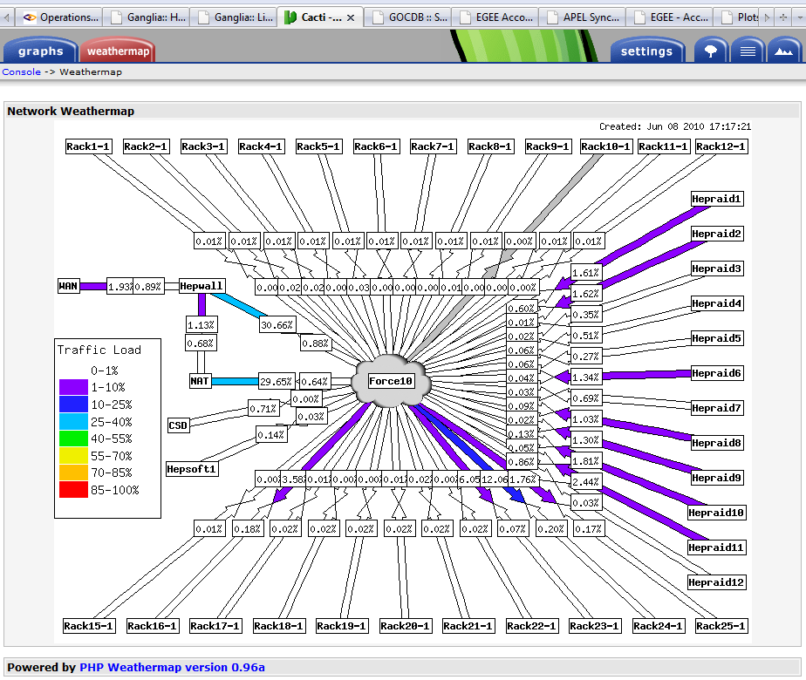
Monitoring - Cacti
Cacti Weathermap

Slide 20

Security
Network security
  University firewall filters off-campus traffic
  Local HEP firewalls to filter on-campus traffic
  Monitoring of LAN devices (and blocking of MAC addresses on switch)
  Single SSH gateway, Denyhosts
  Snort and BASE (need to refine rules to be useful, too many alerts)
Physical security
  Secure cluster room with swipe card access
  Laptop cable locks (some laptops stolen from building in past)
  Promoting use of encryption for sensitive data
  Parts of HEP building publically accessible
Logging
  Server system logs backed up daily, stored for 1 year
  Auditing logged MAC addresses to find rogue devices

Slide 21
Plans and Issues
Replace MAP-2
  Installation of new nodes shouldn’t be a problem
  Getting rid of several hundred Dell PowerEdge 650s more of a challenge
  Still need to think of a name for the new cluster
Possibility of rewiring the network in the Physics building
  Computing Services want to rewire and take over network management for offices
  But there’s asbestos in the building so maybe they don’t
  IPv6
    IANA pool of IPv4 addresses predicted to be exhausted by late 2010 / early 2011
    Need to be ready to switch at some point…
    Would remove any NAT issues!

Slide 22

Conclusion
* New kit in, older kit soon (?) to be replaced
We’re just about keeping on top of things with the resources we have

