Slide 1
RAL PPD Site Update and other odds and ends
Chris Brew

Slide 2
Tier 2/3 This Year
Large expansion:
960 extra Job slots
400 TB more disk
Total Now:
1584 Job Slots
650 TB of Disk

Slide 3
dCache Urgrade and Reconfig
Major dCache upgrade and reconfiguration
Split head node into SRM and dCache Core nodes
Replaced PNFS namespace with chimera
Now at the “golden release”
Simplified configuration
One pool per server
Individual pool groups for major VOs
Minor VOs share “gen” pool groups
Quota’d but setting default space tokens
Causes problem with space publishing

Slide 4
BigMem Worker Nodes
Upgraded 40 WNs to 4GB/core
Supermicro twins, 2xQuad Core CPU so each node has 32GB memory
Still setting up but will quickly enable “hidden” 8GB queue on lcg-CEs
Will allow 16 or 24GB jobs via Glite-CE when we’ve installed it.

Slide 5
Network Upgrade
Installed 10Gb/s Link between R1 Lab 8 and Atlas A5Lower

Slide 6
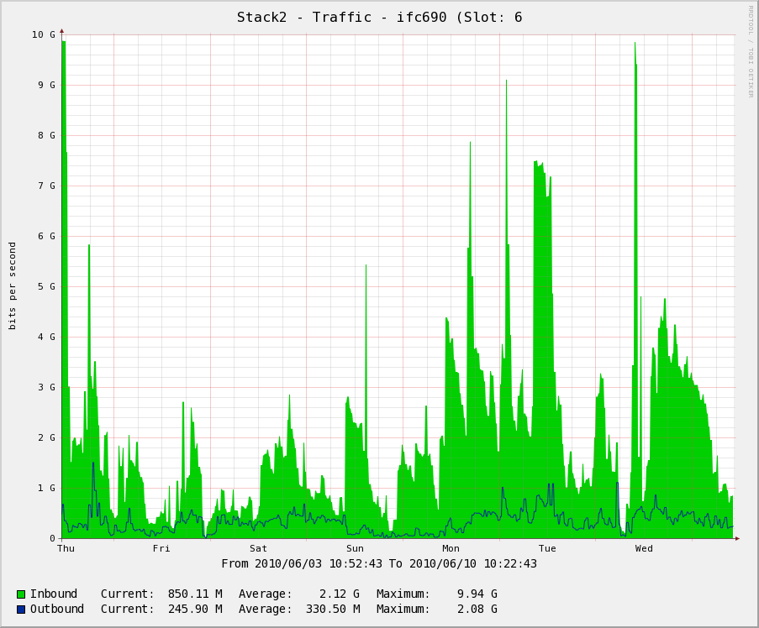

Slide 7
TWiki
Still slightly pre-production
Though some groups already using it
Uses grid certificates for authentication

Slide 8
Windows News
Domain Controllers and Most Servers upgraded to Windows Server 2008
Windows 7 (64bit Professional) being rolled out on Desktops (and a few Laptops)
Home File System now available via WebDAV
On Site, Via PPTP + a few sites that block PPTP

Slide 9
Support Matrix
OS | Desktop | Laptop
Windows | Fully Supported | Fully Supported
Mac OS X | Not Supported | Best Effort
Scientific Linux | Supported | Not Supported
Other Linux | Not Supported | Not Supported

Slide 10
Home File Server Failures
Had Pair of servers for user files
Identical Server + SCSI Raid Shelf
Mirrored every few hours with rsync
Both failed within a few weeks of each other
Now on 2 Old Grid Disk Servers
Home
Expt - Copy
Home - Copy
Expt

Slide 11
Power and Cooling Issues
A number of Power and/or Cooling related outages – should result in improvements to the 30yr old infrastructure
Moved off an overloaded and failing Sub Station
Had full inspection of test of our electrical Installation
Currently on temporary air conditioning while the plant room is fully refurbished

Slide 12
Next Year
New Bastion Host
Host for Mice in place – lockdown is not trivial
New Home File Servers
Will look at LVM Snapshots for this
Upgrade the core network to 2x10Gb/s Links
Explicitly on the Tier 1 tenders for Disk and CPU this year to spend the GridPP Money

