Slide 1
Tier1 - Disk Failure stats and Networking
Martin Bly
Tier1 Fabric Manager

Slide 2
Overview
Tier1 Disk Storage Hardware
Disk Failure Statistics
Network configuration

Slide 3
Tier1 Storage Model
Tier1 provides disk storage for Castor
Particle Physics data (mostly)
Storage is:
Commodity components
Storage-in-a-box
Lots of units

Slide 4
Storage Systems I
Typically 16- or 24-disk chassis
Mostly SuperMicro
One or more hardware RAID cards
3ware/AMCC, Areca, Adaptec, LSI
PCI-X or PCI-e
Some active backplanes
Configured as RAID5 or more commonly RAID6
RAID1 for system disks, on second controller where it fitted
Dual multi-cores CPUs
4GB, 8GB, 12GB RAM
1 GbE NIC
IPMI

Slide 5
Storage Systems II
Year | Chassis | CPU | CPU x Cores | RAM /GB | NIC | IMPI | Units
2005 | 24-bay | AMD 275 | 2 x 2 | 4 | 1 GbE | ✗ | 21
2006 | 16-bay | AMD 275 | 2 x 2 | 4 | 1 GbE | ✗ | 86
2007 A | 16-bay | AMD 2220 | 2 x 2 | 8 | 1 GbE | ✓ | 91
2007 B | 16-bay | Intel 5310 | 2 x 4 | 8 | 1 GbE | ✓ | 91
2008 A | 16-bay | L5410 | 2 x 4 | 8 | 1 GbE | ✓ | 50
2008 B | 16-bay | E5405 | 2 x 4 | 8 | 1 GbE | ✓ | 60
2009 A | 16-bay | E5504 | 2 x 4 | 12 | 1 GbE | ✓ | 60
2009 B | 16-bay | E5504 | 2 x 4 | 12 | 1 GbE | ✓ | 38

Slide 6
Storage Systems III
Year | Controller | Data Drive | Data Drives | Raid | Capacity | Units | Drives
2005 | Areca 1170 | WD5000 | 22 | 6 | 10TB | 21 | 462
2006 | 3ware 9550SX-16ML | WD5000 | 14 | 5 | 6TB | 86 | 1204
2007 A | 3ware 9650SE-16 | WD7500 | 14 | 6 | 9TB | 91 | 1274
2007 B | 3ware 9650SE-16 | WD7500 | 14 | 6 | 9TB | 91 | 1274
2008 A | Areca 1280 | WD RE | 22 | 6 | 20TB | 50 | 1100
2008 B | 3ware 9650SE-24 | WD RE | 22 | 6 | 20TB | 60 | 1320
2009 A | LSI 8888-ELP | WD RE4-GP | 22 | 6 | 38TB | 60 | 1320
2009 B | Adaptec 52445 | Hitachi | 22 | 6 | 40TB | 38 | 836
 |  |  |  |  |  | 497 | 8790

Slide 7
Storage Use
Servers are assigned to a Service Classes
Each Virtual Organisation (VO) has several Service Classes
Usually between 2 and many servers per service class
Service Classes are either:
D1T1: data is on both disk and tape
D1T0: data is on disk but NOT tape
If lost, VO gets upset :-(
D0T1: data is on tape – disk is a buffer
D0T0: ephemeral data on disk
Service Class type assigned VO depending on their data model and what they want to do with a chunk of storage

Slide 8
System uses
Want to make sure data is as secure as possible
RAID5 is not secure enough:
Only 1 disk failure can put data at risk
Longer period of risk as rebuild time increases due to array/disk sizes
Even with host spare, risk of double failure is significant
Keep D1T0 data on RAID6 systems
Double parity information
Can lose two disks before data is at risk
Tape buffer systems need throughput (network bandwidth) not space
Use smaller capacity servers in these Service Classes

Slide 9
Disk Statistics

Slide 10
2009 High(Low!)lights
Drives failed / changed: 398 (9.4% !)
Multiple failure incidents: 21
Recoveries from multiple failures: 16
Data copied to another file system: 1
Lost file systems: 4

Slide 11
2009 Data
Month | Clustervision 05 | Viglen 06 | Viglen 07a | Viglen 07i | WD 500GB | WD 750GB | Seagate 750GB |  | All
Jan | 6 | 18 | 3 | 2 | 24 | 3 | 2 |  | 29
Feb | 1 | 16 | 4 | 5 | 17 | 4 | 5 |  | 26
Mar | 3 | 17 | 4 | 3 | 20 | 4 | 3 |  | 27
Apr | 1 | 21 | 1 | 2 | 22 | 1 | 2 |  | 25
May | 4 | 13 | 6 | 6 | 17 | 6 | 6 |  | 29
Jun | 3 | 14 | 6 | 5 | 17 | 6 | 5 |  | 28
Jul | 6 | 30 | 6 | 5 | 36 | 6 | 5 |  | 47
Aug | 1 | 31 | 10 | 6 | 32 | 10 | 6 |  | 48
Sep | 13 | 13 | 3 | 5 | 26 | 3 | 5 |  | 34
Oct | 7 | 28 | 1 | 4 | 35 | 1 | 4 |  | 40
Nov | 12 | 19 | 0 | 3 | 31 | 0 | 3 |  | 34
Dec | 9 | 16 | 2 | 4 | 25 | 2 | 4 |  | 31
Total | 66 | 236 | 46 | 50 | 302 | 46 | 50 |  | 398
Average/month | 5.50 | 19.67 | 3.83 | 4.17 | 25.17 | 3.83 | 4.17 |  | 33.1667
Base | 462 | 1204 | 1274 | 1274 | 1688 | 1274 | 1274 |  | 4214
% fail | 14.3% | 19.6% | 3.6% | 3.9% | 17.9% | 3.6% | 3.9% |  | 9.4%

Slide 12
Failure by generation

Slide 13
By drive model

Slide 14
Normalised Drive Failure Rates

Slide 15
2009 Multiple failures data
 |  |  | Viglen 06 |  |  |  | Viglen 07a |  |  |  | Viglen 07i |  |  |  |  | All
Days | Month | Clustervision 05 | Saved | Copied | Lost | Total Doubles | Saved | Copied | Lost | Total Doubles | Saved | Copied | Lost | Total Doubles |  | Saved | Copied | Lost | Total Doubles
31 | Jan | 0 | 1 |  |  | 1 |  |  |  | 0 |  |  |  | 0 |  | 1 | 0 | 0 | 1
28 | Feb | 0 | 1 |  |  | 1 | 1 |  |  | 1 |  |  |  | 0 |  | 2 | 0 | 0 | 2
31 | Mar | 0 | 1 |  | 1 | 2 |  |  |  | 0 |  |  |  | 0 |  | 1 | 0 | 1 | 2
30 | Apr | 0 | 1 |  |  | 1 |  |  |  | 0 | 1 |  |  | 1 |  | 2 | 0 | 0 | 2
31 | May | 0 |  |  |  | 0 |  |  |  | 0 |  |  |  | 0 |  | 0 | 0 | 0 | 0
30 | Jun | 0 |  |  |  | 0 |  |  |  | 0 |  |  |  | 0 |  | 0 | 0 | 0 | 0
31 | Jul | 0 | 1 |  |  | 1 | 1 |  |  | 1 |  |  |  | 0 |  | 2 | 0 | 0 | 2
31 | Aug | 0 | 4 | 1 |  | 5 | 1 |  |  | 1 | 1 |  |  | 1 |  | 6 | 1 | 0 | 7
30 | Sep | 0 |  |  | 1 | 1 |  |  |  | 0 |  |  |  | 0 |  | 0 | 0 | 1 | 1
31 | Oct | 0 | 2 |  |  | 2 |  |  |  | 0 |  |  |  | 0 |  | 2 | 0 | 0 | 2
30 | Nov | 0 |  |  | 2 | 2 |  |  |  | 0 |  |  |  | 0 |  | 0 | 0 | 2 | 2
31 | Dec |  |  |  |  | 0 |  |  |  | 0 |  |  |  | 0 |  | 0 | 0 | 0 | 0
365 | Total | 0 | 11 | 1 | 4 | 16 | 3 | 0 | 0 | 3 | 2 | 0 | 0 | 2 |  | 16 | 1 | 4 | 21
 | Average/month | 0.00 |  |  |  | 1.33 |  |  |  | 0.25 |  |  |  | 0.17 |  | 1.33 | 0.08 | 0.33 | 1.75

Slide 16
Lost file systems (arrays)

Slide 17
Closer look: Viglen 06
Why are Viglen 06 servers less reliable?
RAID5?
More vulnerable to double disk failure causing a problem
Controller issues?
Yes: Failure to start rebuilds after a drive fails
Yes: Some cache RAM issues
System RAM?
Yes: ECC not set up correctly in BIOS
Age?
Possibly: difficult to assert with confidence
Disks?
Hmmm....

Slide 18
Viglen 06 – Failures per server

Slide 19
Viglen 06 failures - sorted
Batch 2
Batch 1

Slide 20
Summary
Overall failure rate of drives is high (9.4%)
Dominated by WD 500GB drives (19.6%)
Rate for 750GB drives much lower (3.75%)
Spike in failures:
at the time of the Tier1 migration to R89
when air conditioning in R89 failed
Batch effect for Viglen 06 generation

Slide 21
Networking

Slide 22
Tier1 Network - 101
Data network
Central core switch: Force10 C300 (10GbE)
Edge switches: Nortel 55xx/56xx series stacks
Core-to-Edge: 10GbE or 2 x 10GbE
All nodes connected at 1 x GbE for data
Management network
Various 10/100MbE switches: NetGear, 3Com
New and salvaged from old data network
Uplinks
10Gb/s to CERN (+ failover)
10Gb/s to Site LAN
10Gb/s + 10Gb/s failover to SJ5 (to be 20Gb/s each soon)
Site routers: Nortel 8600 series

Slide 23
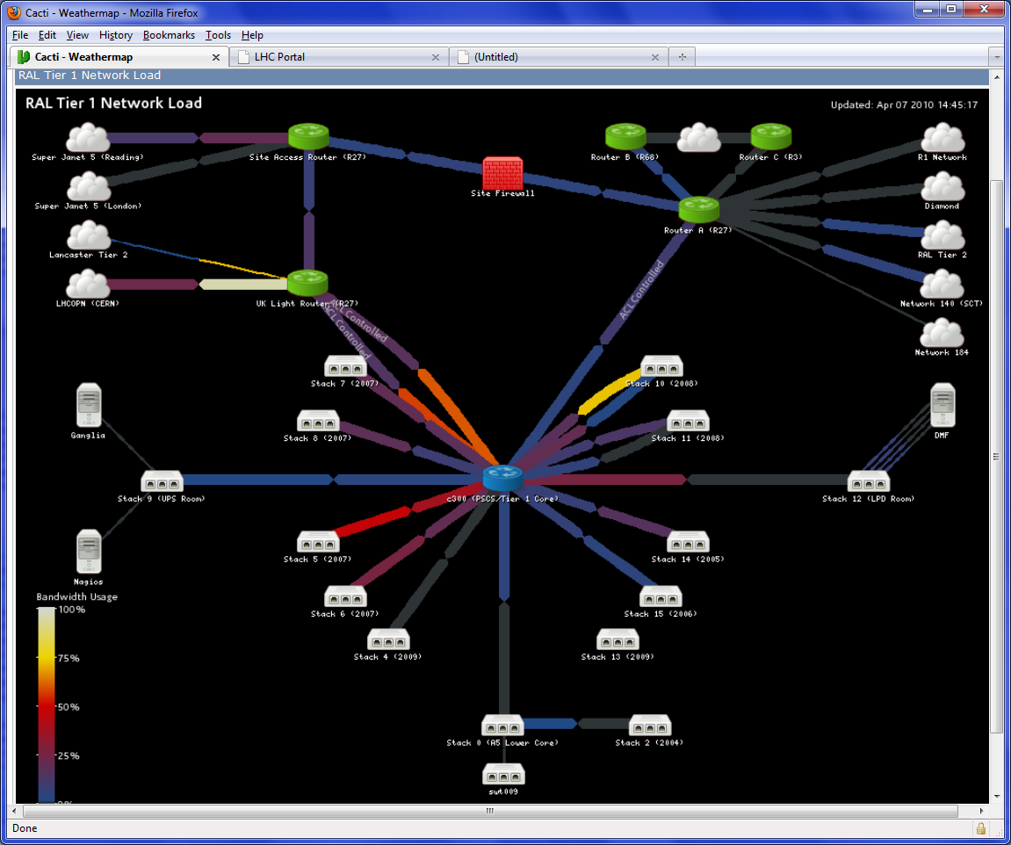

Slide 24
Tier1 Network 102
Tier1 has a class 21 network within the site range
~2000 addresses
Need to have a dedicated IP range for the LCHOPN
Class 23 network within existing subnet
~500 addresses, Castor disk servers only

Slide 25
Tier1 Network 103 - routing
General nodes
Gateway address on site router
All traffic goes to Router A
From there to site or off site via firewall and Site Access Router (SAR)
OPN nodes
Gateway address on UKLight router
Special routes to Router A for site only traffic
All off-site traffic to UKLight router
UKLight router
BGP routing information from CERN
T0, T1<->T1 traffic directed to CERN link
Lancaster traffic -> link to Lancaster
Other traffic from RAL Tier1 up to SAR (the bypass)
SAR
Filters inbound traffic for Tier1 subnet
OPN machines to Core via UKLight router
Others to Router A via Firewall
Non-Tier1 traffic not affected

Slide 26
Logical network
UKLR
OPN
Tier1 Subnet
OPN Subnet
SAR
SJ5
Firewall
Site
Router A

Slide 27
Tier1 Network 104 - firewalling
Firewall is a NetScreen
10Gb/s linespeed
Site FW policy:
closed inbound except by request on port/host (local/remote) basis
Open outbound
Port 80 + kin redirected via web caches...
Tier1 subnet:
As Site except port 80 + kin do not use web caches
OPN subnet:
Traffic is filtered at SAR – only Castor ports open

