Slide 1
NGS – INCA Monitoring David Spence – University of Oxford Shiv Kaushal – University of Leeds

Slide 2
Why Monitor?
Membership
Management
Operations
Users

Slide 3
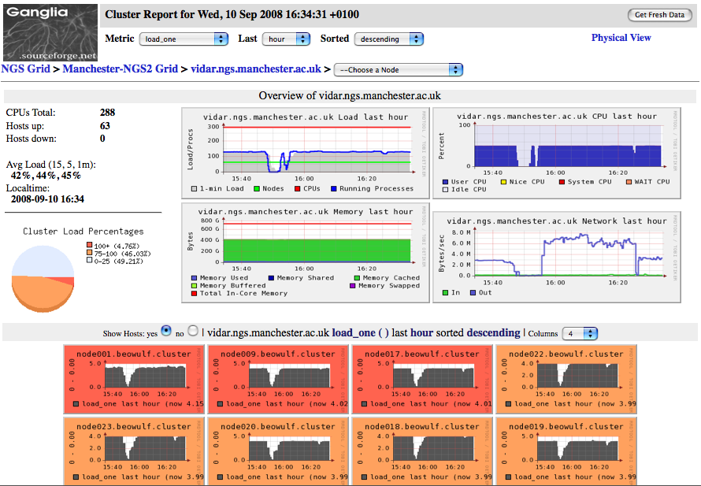
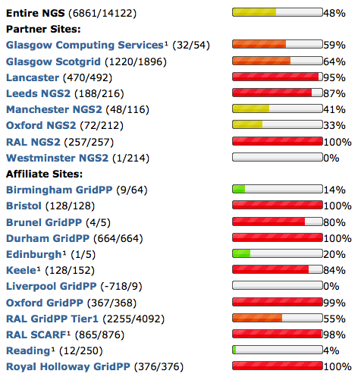
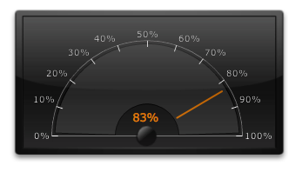
Other monitoring
Ganglia
http://ganglia.ngs.rl.ac.uk/
Load Monitor
http://www.ngs.ac.uk/load-monitor

Slide 4
What is Inca?
Produced by SDSC for Terragrid
NGS uses version 2.0
Features
Grid
Centralised
Reporters
User level

Slide 5
Inca for the NGS
Value based reporters
Remote testing
Custom display
Historical views
Management Reports
Email notifications
Configuration

Slide 6
Admin
Write reporters
Reporter
Repository
Data
Consumer
Configure
r
NGS Oracle DB
Incat
C
Agent
S
Depot
r
S
S
R
r
R
Key
C
Configuration
Reporter
Manager
Reporter
Manager
S
Suite
Testing
Reporter
Reporter
Reporter
Reporter
Reporter
Reporter
Reporter
Reporter
Reporter
Reporter
Reporter
Reporter
Reporter
Reporter
Reporter
Reporter
Reporter
Reporter
r
Reporter
R
Report
Site A
Site B

Slide 7
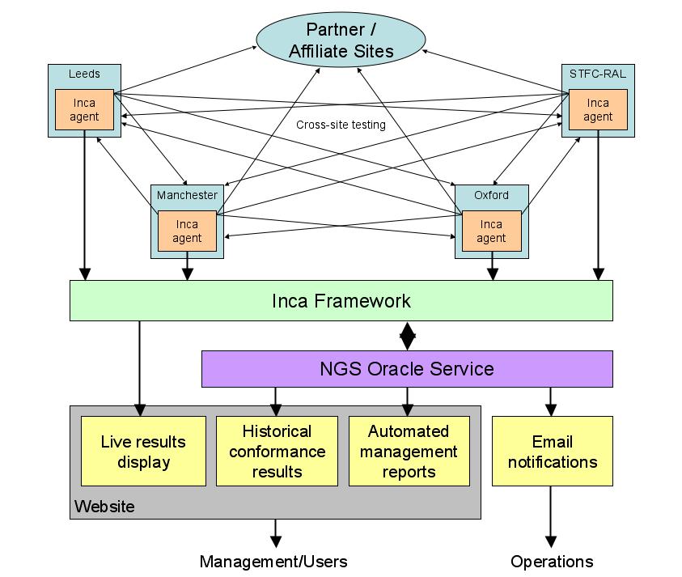

Slide 8
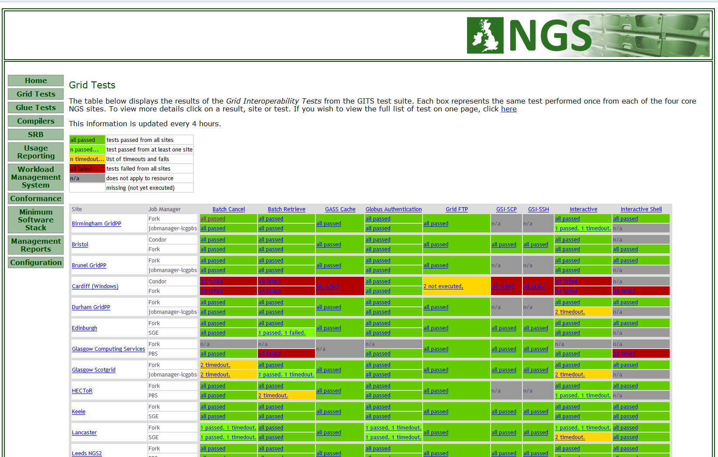
Basic Inca display

Slide 9
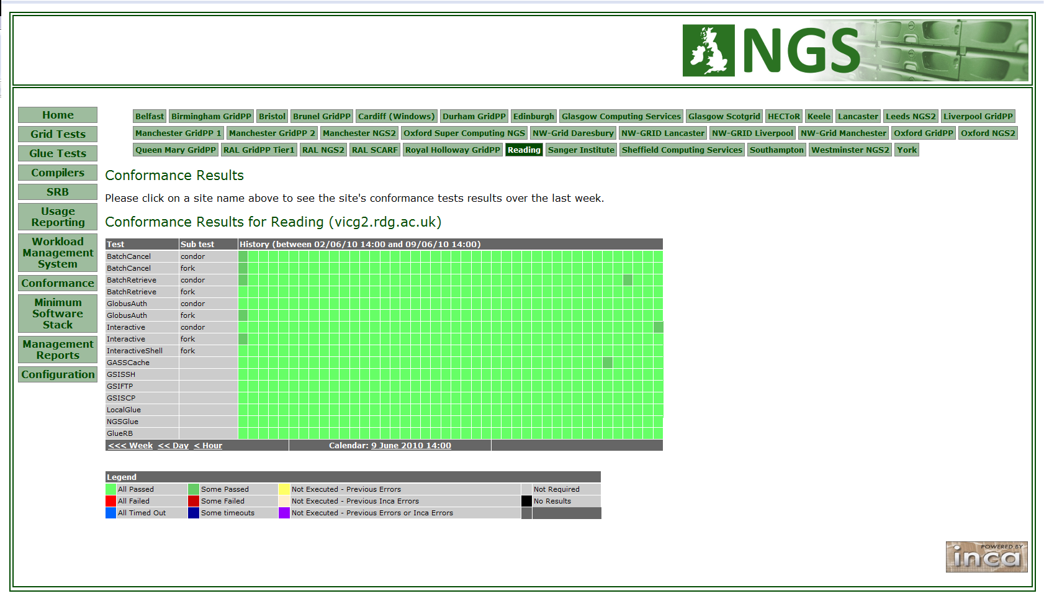
Historical - Conformance

Slide 10
Management Reports

Slide 11
What Next?
EGEE Nagios system
Simple Inca interface
Nagios reporter

Slide 12
http://inca2.ngs.ac.uk/

