Slide 1
HEPiX Summary
HEPSysMan Meeting
University of Birmingham
Martin Bly

Slide 2
Disclaimer
Significant parts borrowed (stolen) from Michel Jouvin presentation to GDB, Nov ’10, and various talks at HEPiX

Slide 3
HEPiX Facts
19 years old, meets twice a year for a week
Europe (Spring), North America (Fall)
Open to any one dealing with fabric management in HEP
Mostly system administrators but also service manages
Working groups for specific issues (benchmarking, storage, virtualisation)
Meeting at Cornell University, Ithaca, NY
60 participants from 24 sites including Korea, Taiwan

Slide 4
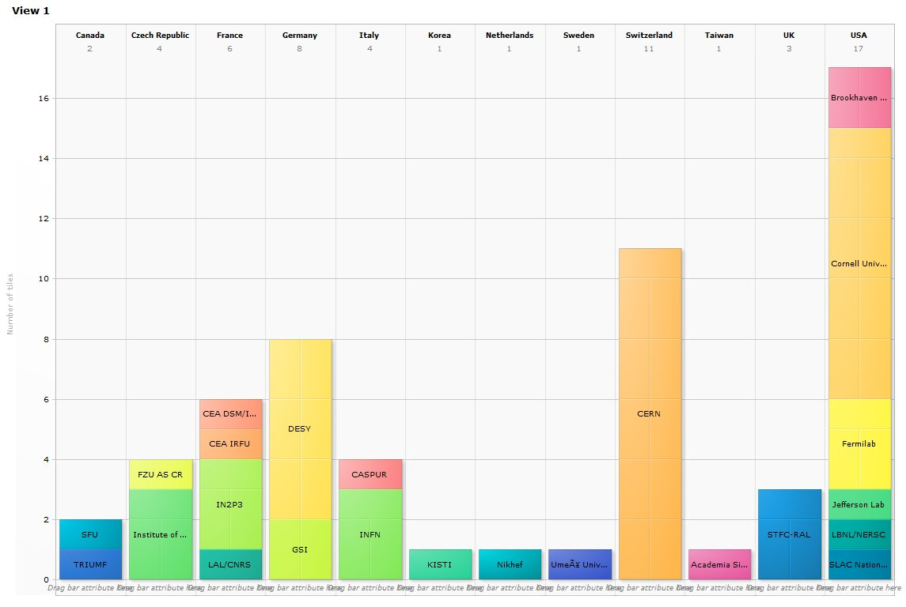
Meeting Attendance

Slide 5
IPV6
IPV6
A topic in the background since 2 years
NorduGrid presentation in Umea (Spring 2008)
Fred Baker (CISCO): IPv4/v6 transition (Fall 2008)
INFN testbed (Fall 2010)
A memo from US Federal CIO asking for concrete plans to be in place by the end of this year
http://www.cio.gov/Documents/IPv6MemoFINAL.pdf
Shortage of Ipv4 addresses expected next Fall.
Will affect non European/North American countries first
A WG to be created soon
Identify operational issues and discuss a possible test bed

Slide 6
File Systems and Storage
Very active track, coordinated by Working Group
Test bed at KIT (Karlsruhe) to compare solutions
Using mainly apps provided by experiments, new versions received after Amsterdam Jamboree
New tests run after Amsterdam: assessment of ROOT TTreeCache effect on previous measurements
Not able to set Xrootd to file system performance level, mainly compensate absence of kernel caching
Also improves a little bit file system performances
New report on NFS 4.1 as an access protocol
Very promising results based on dCache tests
DPM should have an implementation ready for testing by the end of the year
CERN presentation about EOS prototype
People present expressed doubts about the feasibility of such a project without a large team…
Several previous experiences showed that an appealing prototype is easy but production-quality is very long/hard
Also concerns about a product restricted to Xrootd access protocol

Slide 7
Virtualisation & Clouds
Report from the virtualization WG formed 1 year ago (Berkeley meeting) with focus on trusted VM images
First prototype of VMIC (VM image Catalog) in use at CERN
More work needed for VMIC interconnection between endorsers and sites: liaise with StratusLab?
JSPG policy adoption after wider experience
Several sites started private cloud infrastructures
Presentations from CERN, FNAL, LBNL
Connected with grid WNs at CERN
Many sites leveraging virtualisation for production resilience
Significant interest in CVMFS work – Ian Collier
StratusLab just released first version of its toolkit
Should ease deployment of private clouds to run grid services, e.g. grid WNs

Slide 8
Oracle / SUN
Many sites expressed concerns about former Sun products since buyout by Oracle
Impact both HW and SW products including Thor, ZFS…
LUSTRE: Two consortiums founded to drive further developments of LUSTRE
US: Livermore + DDN + some big players, very high membership fees (500 k$/year)
Europe: more open to small institutes... €3k?
Grid Engine: a SourceForge project (fork) started
Oracle saying they want to avoid forks…
HEPiX sites encouraged to participate to these initiatives

Slide 9
Other Topics
Data centres: several projects underway
CC IN2P3 extension on schedule: to be delivered next Feb.
CERN project to extend current CC infrastructure
GSI: first prototype of their 3D cube concept presented in Berkeley (Fall 2009)
OS: discussions between SL and SLC team to better integrate SLC contribution in SL
Unify distributions if possible, still keeping CERN specificities
Benefit from CERN ability to contribute to kernel patching

Slide 10
Scientific Linux
Continue to have security updates for all releases of SL 4
Continue to have fastbug updates for only the latest release of SL 4
Continue to have security updates for all releases of SL 5
Continue to have fastbug updates for only the latest release of SL 5
Releasing S.L. 4.9
Estimate - ?? - Not even sure if there will be a 4.9
Releasing S.L. 5.5
Estimate - Spring 2011 ??
When RHEL 6 comes out, releasing S.L. 6.0
RHEL 6 released – November 2010
Will not release SL 6 until “it is ready” - estimate - April 2011
More open environment for building SL
Working on Koji, Bodhi, Mash, Pungi, Revisor, Spacewalk

Slide 11
Sites
SLAC: DOE enforced monitoring: immediate ‘don’t look at pr0n’ memo.
Several site reporting significant use of GPU clusters (Lattice QCD) – some reporting QA issues
GSI ‘Cube’ concept demonstrator
Significant water cooling infrastructure being deployed

Slide 12
Interesting Stuff
CERN
Distcc
Win7, Exchange 2010 rollout and anti-spam
IT facilities planning and procurement
IN2P3 – new network infrastructure

