Slide 1
Delivering Experiment Software to WLCG sites A new approach using the CernVM Filesystem (cvmfs)
Ian Collier – RAL Tier 1
ian.collier@stfc.ac.uk
HEPSYSMAN November 22nd 2010, Birmingham

Slide 2
Contents
What’s the problem?
What is cvmfs - and why might it help?
Experiences at PIC
Experiences at RAL
Future

Slide 3
So, what’s the problem?
Experiment application software (and conditions databases) is currently installed in a shared area of individual site (NFS, AFS…)
The software is installed by jobs which run on a privileged node of the computing farm, these must be run at all sites

Slide 4
So, what’s the problem? II
Issues observed with this model include:
_{NFS scalability issues}
at RAL we see BIG load issues, especially for Atlas
Upgrading the NFS server helped – but problem has not gone away
_{at} PIC they see huge loads for LHCb
Shared area sometimes not reachable (stale mounts on the WN, or the NFS server is too busy to respond)
Software installation in many Grid sites is a tough task (job failures, resubmission, tag publication...)
Space on performant NFS servers is expensive
if VOs want to install new releases and keep the old ones they have to ask for quota increases
In the three months to September there were 33 GGUS tickets related to shared software area issues for LHCb

Slide 5
What might help?
A caching file system would be nice – some sites use AFS but install jobs seem still to be very problematic
A read only file system would be good
A system optimised for many duplicated files would be nice

Slide 6
What, exactly, is cvmfs?
It is not, really, anything to do with virtualisation
A client-server file system
Originally developed to deliver VO software distributions to (cernvm) virtual machines in a fast, scalable, and reliable way.
Implemented as a FUSE module
Makes a specially prepared directory tree stored on a web server look like a local read-only file system on the local (virtual or physical) machine.
Uses only outgoing HTTP connections
Avoids most of the firewall issues of other network file systems.
Transfers data file by file on demand, verifying the content by SHA1 keys.

Slide 7
What is cvmfs? - Software Distribution
Essential Properties:
∙ Distribution of read-only binaries
∙ Files and file meta data are downloaded on demand and cached locally
∙ Intermediate squids reduce network traffic further
∙ File based deduplication – a side effect of the hashing
∙ Self-contained (e. g. /opt/atlas), does not interfere with base system

Slide 8
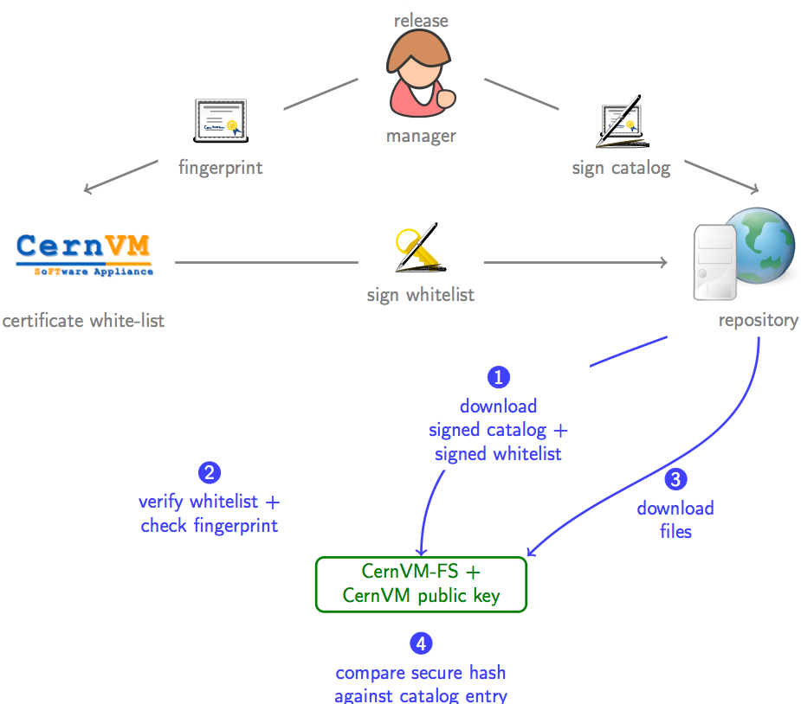
What is cvmfs? – Integrity & authenticity
Principle: Digitally signed repositories with certificate white-list

Slide 9
What is cvmfs? – Repository statistics
Note how small the bars for unique files are
- both in numbers and by volume
The hashing process identifies duplicate files and once they are cached they are never transferred twice

Slide 10
Tests at PIC
Set out to compare performance at WN in detail
Metrics measured
Execution time for SetupProject - the most demanding phase of the job for the software area (huge amount of stat() and open() calls )
Execution time for DaVinci
Dependence on the number of concurrent jobs

Slide 11
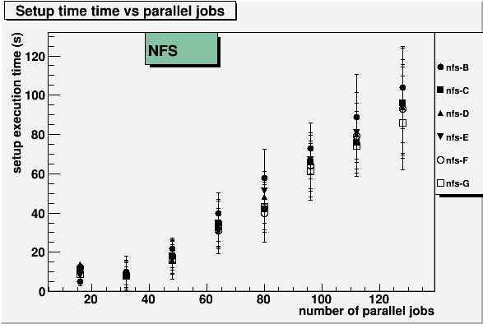
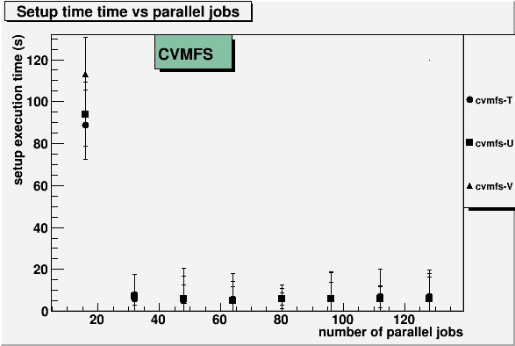
Tests at PIC – setup time

Slide 12
Tests at PIC – setup time

Slide 13
Tests at PIC – local cache size
LHCb:
One version of DaVinci (analysis package): the software takes 300 MB + CernVMFS catalogue overhead, total space: 900 MB
The catalog contains file metadata for all LHCb releases
Download once (for every new release) and then keep in cache
Each additional version of DaVinci exceuted adds 100 MB
ATLAS:
One release of Athena: 224MB of SW + catalog files: 375MB
The overhead is less since the catalog has been more optimised for ATLAS software structure

Slide 14
Tests at RAL
More qualitative
Interested in scalability for servers
Focus on how well it might replace overloaded NFS server
Have not examined in such detail at what happens at the client
Have confirmed that we can run through 10-20000 jobs with no problems

Slide 15
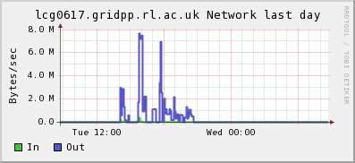
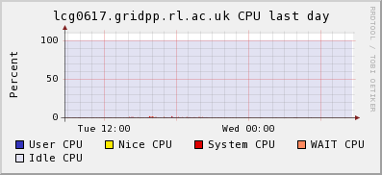
Tests at RAL – Atlas Monte Carlo
Early test with 800 or so jobs – the squid barely missed a beat

Slide 16
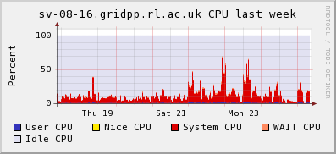
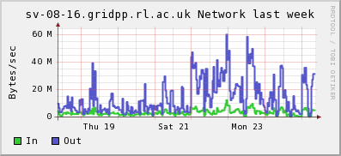
Tests at RAL – Atlas Monte Carlo
In the same period the NFS Atlas SW server – with 1500 or so jobs running

Slide 17
Tests at RAL – Atlas Hammercloud tests
Average over several sites

Slide 18
Tests at RAL – Atlas Hammercloud tests
6150 jobs at RAL

Slide 19
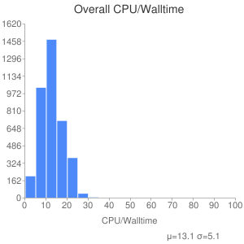
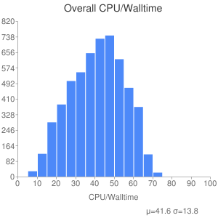
Tests at RAL – Atlas Hammercloud tests
Lets look in more detail – CPU/Walltime
Average over several sites
RAL

Slide 20
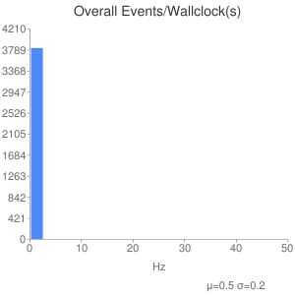
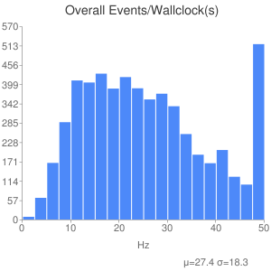
Tests at RAL – Atlas Hammercloud tests
Lets look in more detail – Events/Wallclock
Average over several sites
RAL

Slide 21
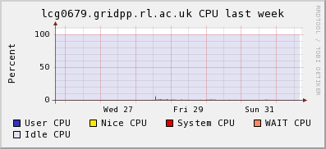
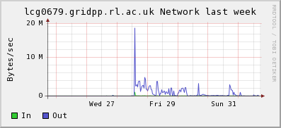
Tests at RAL – Atlas Monte Carlo
Since reconfiguring cvmfs and starting analysis jobs– the squid again happy
Worth noting that even at the point the network is busiest – cpu is not -

Slide 22
Tests at RAL – Load on Squids
Not quite negligible - but very manageable
For initial tests squid was running on the retired Atlas software server (5 year old WN)
Separate from other frontier squids
For resilience (rather than load) we have added a second squid – client randomly mounts one or the other
- failover appears transparent
Starting to accept Atlas user analysis jobs which will all use cvmfs - on an experimental basis
Will learn much more
Will use wider range of releases – should stress chaches more than current production and test jobs
Over last weekend removed limits – squids still happy

Slide 23
Current State of CernVM-FS
Network file system designed for software repositories
Serves 600 GB and 18.5 Million files and directories
Revision control based on catalog snapshots
Outperforms NFS and AFS
Warm cache speed comparable to local file system
Scalable infrastructure
Integrated with automount/autofs
Delivered as rpm/yum package – and as part of CernVM
Atlas, LHCb, Alice, CMS… all supported
Active Developments
Failover-Mirror of the source repositories
(CernVM-FS already supports automatic host failover)
Extend to conditions databases
Service to be supported by Cern IT (http://sls.cern.ch/sls/service.php?id=cvmfs)
Security audit – in progress
Client submitted for inclusion with SL

Slide 24
Summary
Good for sites
Performance at client is better
Squid very easy to set up and maintain – and very scalable
Much less network traffic
Good for VOs
VOs can install each release once – at CERN
No more local install jobs
Potentially useful for hot files to

Slide 25
Acknowledgements & Links
Thanks to
Jakob Blomer (jakob.blomer@cern.ch) who developed cvmfs
Elisa Lanciotti (elisa.lanciotti@cern.ch)who carried out the tests at PIC
Alastair Dewhurst & Rod Walker who’ve been running the Atlas tests at RAL
Links
PIC Tests:
https://twiki.cern.ch/twiki/bin/view/Main/ElisaLanciottiWorkCVMFSTests
Elisa’s talk at September 2010 GDB
RAL cvmfs squids:
http://ganglia.gridpp.rl.ac.uk/ganglia/?r=day&c=Services_Core&h=lcg0679.gridpp.rl.ac.uk
http://ganglia.gridpp.rl.ac.uk/ganglia/?r=day&c=Services_Core&h=lcg0617.gridpp.rl.ac.uk
CVMFS Downloads:
https://cernvm.cern.ch/project/trac/cernvm/downloads
CVMFS Technical Paper:
https://cernvm.cern.ch/project/trac/cernvm/export/1693/cvmfs-tr/cvmfstech.preview.pdf
Jakob’s talk from CHEP:
http://117.103.105.177/MaKaC/contributionDisplay.py?contribId=39&sessionId=111&confId=3

