Slide 1

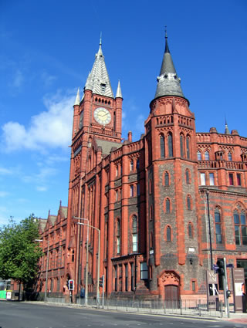
Liverpool HEP - Site Report
June 2009
John Bland, Robert Fay

Slide 2

Staff Status
One member of staff left in the past year:
Dave Muskett, long term illness June 2008
Two full time HEP system administrators
John Bland, Robert Fay
One full time Grid administrator (0.75FTE)
Steve Jones, started September 2008
Not enough!

Slide 3
Current Hardware - Users
Desktops
~100 Desktops: Scientific Linux 4.3, Windows XP, Legacy systems
Minimum spec of 3GHz ‘P4’, 1GB RAM + TFT Monitor
Laptops
~60 Laptops: Mixed architecture, Windows+VM, MacOS+VM, Netbooks
‘Tier3’ Batch Farm
Software repository (0.5TB), storage (3TB scratch, 13TB bulk)
‘medium’, ‘short’ queues consist of 40 32bit SL4 (3GHz P4, 1GB/core)
‘medium64’ queue consists of 7 64bit SL4 nodes (2xL5420, 2GB/core)
5 interactive nodes (dual 32bit Xeon 2.4GHz, 2GB/core)
Using Torque/PBS/Maui+Fairshares
Used for general, short analysis jobs

Slide 4
Current Hardware – Servers
46 core servers (HEP+Tier2)
48 Gigabit switches
1 High density Force10 switch
Console access via KVMoIP
LCG Servers
SE upgraded to new hardware:
  SE now 8-core Xeon 2.66GHz, 10GB RAM, Raid 10 array
CE, SE, UI all SL4, GLite 3.1
Mon still SL3, GLite 3.0, BDII SL4, Glite 3.0, Updating soon (VM)
Using VMs more for testing new service/node types
  VMware ESXi (jumbo frame support)
    Some things awkward to configure
    Hardware (particularly disk) support limited

Slide 5
Current Hardware – Nodes
MAP2 Cluster
24 rack (960 node) (Dell PowerEdge 650) cluster
2 racks (80 nodes) shared with other departments
Each node has 3GHz P4, 1-1.5GB RAM, 120GB local storage
20 racks (776 nodes) primarily for LCG jobs (2 racks shared with local ATLAS/T2K/Cockcroft jobs)
1 rack (40 nodes) for general purpose local batch processing
Each rack has two 24 port gigabit switches, 2Gbit/s uplink
All racks connected into VLANs via Force10 managed switch/router
  1 VLAN/rack, all traffic Layer3
  Less broadcast/multicast noise, trickier routes (eg DPM dual homing)
Supplementing with new 8core 64bit nodes (56cores and rising)
Retiring badly broken nodes
  Hardware failures on a weekly basis

Slide 6

Storage
RAID
Majority of file stores using RAID6. Few legacy RAID5+HS.
Mix of 3ware and Areca SATA controllers on Scientific Linux 4.3.
Adaptec SAS controller for grid software.
Arrays monitored with 3ware/Areca web software and email alerts.
Software RAID1 system disks on all new servers/nodes.
File stores
13TB general purpose ‘hepstore’ for bulk storage
3TB scratch area for batch output (RAID10)
2.5TB high performance SAS array for grid/local software
Sundry servers for user/server backups, group storage etc
150TB (230TB soon) RAID6 for LCG storage element (Tier2 + Tier3 storage/access via RFIO/GridFTP)

Slide 7
Storage - Grid
Storage Element Migration
  Switched from dCache to DPM August 2008
  Reused dCache head/pool nodes
  ATLAS User data temporarily moved to Glasgow
    Other VO data deleted or removed by users
  Production and ‘dark’ dCache data deleted from LFC
    Luckily coincided with big ATLAS SRMv1 clean up
  Required data re-subscribed onto new DPM
Now running head node + 8 DPM pool nodes, ~150TB of storage
  This is combined LCG and local data
  Using DPM as ‘cluster filesystem’ for Tier2 and Tier3
  Local ATLASLIVERPOOLDISK space token
  Another 80TB being readied for production (soak tests, SL5 tests)
Closely watching Lustre-based SEs

Slide 8
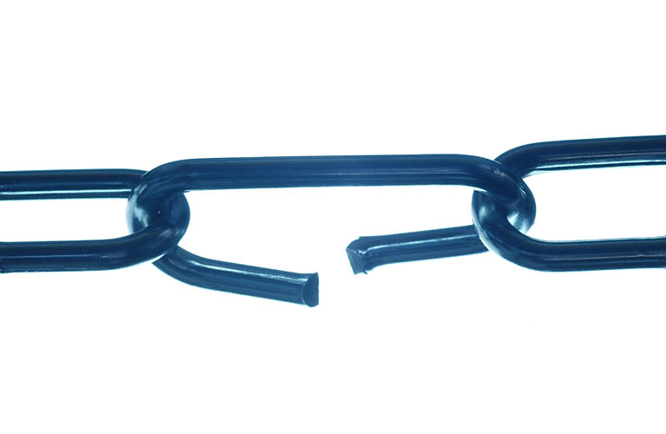
Joining Clusters
New high performance central Liverpool Computing Services Department (CSD) cluster
Physics has a share of the CPU time
Decided to use it as a second cluster for the Liverpool Tier2
  Only extra cost was second CE node (£2k)
Liverpool HEP attained NGS Associate status
  Can take NGS-submitted jobs from traditional CSD serial job users
  Sharing load across both clusters more efficiently
Compute cluster in CSD, Service/Storage nodes in Physics
Need to join networks (10G cross-campus link)
  New CE and CSD systems sharing a dedicated VLAN
  Layer2/3 working but problem with random packets DOSing switches
  Hope to use CSD link for off-site backups for disaster recovery

Slide 9
Joining Clusters
CSD nodes 8core x86_64, SuSE10.3 on SGE
  Local extensions to make this work with Atlas software
  Moving to SL5 soon
  Using tarball WN + extra software on NFS (no root access to nodes)
Needed a high performance central software server
  Using SAS 15K drives and 10G link
  Capacity upgrade required for local systems anyway (ATLAS!)
  Copes very well with ~800nodes apart from jobs that compile code
    NFS overhead on file lookup is the major bottleneck
Very close to going live once network troubles sorted
  Relying on remote administration frustrating at times
  CSD also short-staffed, struggling with hardware issues on the new cluster

Slide 10
HEP Network topology
1G
2G
1G
1-3G
10G
192.168 Research VLANs
2G x 24
1500MTU
9000MTU

Slide 11

Building LAN Topology
Before switch upgrades

Slide 12
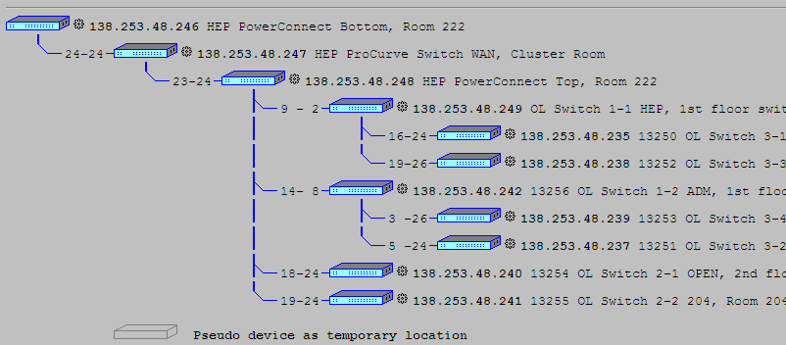
Building LAN Topology
After switch upgrades + LanTopolog

Slide 13
Configuration and deployment
Kickstart used for OS installation and basic post install
Previously used for desktops only
Now used with PXE boot for automated grid node installs
Puppet used for post-kickstart node installation (glite-WN, YAIM etc)
Also used for keeping systems up to date and rolling out packages
Recently rolled out to desktops for software and mount points
Custom local testnode script to periodically check node health and software status
Nodes put offline/online automatically
Keep local YUM repo mirrors, updated when required, no surprise updates (being careful of gLite generic repos)

Slide 14
Monitoring
Ganglia on all worker nodes and servers
Use monami with ganglia on CE, SE and pool nodes
  Torque/Maui stats, DPM/MySQL stats, RFIO/GridFTP connections
Nagios monitoring all servers and nodes
  Basic checks at the moment
  Increasing number of service checks
  Increasing number of local scripts and hacks for alerts and ticketing
Cacti used to monitor building switches
  Throughput and error readings
Ntop monitors core Force10 switch, but unreliable
  sFlowTrend tracks total throughput and biggest users, stable
LanTopolog tracks MAC addresses and building network topology (first time the HEP network has ever been mapped)

Slide 15
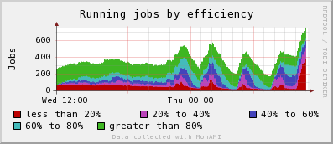
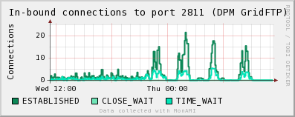
Monitoring - Monami

Slide 16
Monitoring - Cacti
Cacti

Slide 17

Security
Network security
  University firewall filters off-campus traffic
  Local HEP firewalls to filter on-campus traffic
  Monitoring of LAN devices (and blocking of MAC addresses on switch)
  Single SSH gateway, Denyhosts
Physical security
  Secure cluster room with swipe card access
  Laptop cable locks (some laptops stolen from building in past)
  Promoting use of encryption for sensitive data
  Parts of HEP building publically accessible, BAD
Logging
  Server system logs backed up daily, stored for 1 year
  Auditing logged MAC addresses to find rogue devices

Slide 18

Planning for LHC Data Taking
Think the core storage and LAN infrastructure is in place
Tier2 and Tier3 cluster and services stable and reliable
Increase Tier3 CPU capacity
  Using Maui+FS
  Still using Tier2 storage
Need to push large local jobs to LCG more
  Access to more cpu and storage
  Combined clusters, less maintenance
  Lower success rate (WMS) but ganga etc can help
Bandwidth, Bandwidth, Bandwidth
  Planned increase to 10G backbone
  Minimum 1G per node
  Bandwidth consumption very variable
  Shared 1G WAN not sufficient
  Dedicated 1G WAN probably not sufficient either

Slide 19

Ask the audience
Jumbo frames? Using? Moving to/from?
  Lower CPU overhead, better throughput
  Fragmentation and weird effects with mixed MTUs
10G Networks? Using? Upgrading to?
  Expensive? Full utilisation?
IPv6? Using? Plans?
  Big clusters, lots of IPs, not enough University IPs available
  Do WNs really need a routable address?

